Slide 1
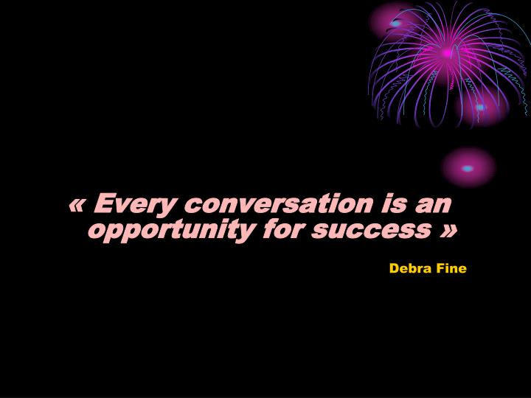
CONVERSATIONAL SKILLLS

Slide 2
Conversation skills can be divided into the following:
Greetings
Small talk
Expanding and maintaining your conversation
Seeing off

Slide 3
Small Talk
Small talk is
a casual form of conversation that ‘breaks the ice’ or fills an awkward silence between people.
Even though you may feel shy using your second language, it is sometimes considered rude to say nothing.

Slide 4
TASK: Give your opinions.
Generally, how do you start a conversation when meeting strangers and/or acquaintances?
What kind of greetings do you use?
What do you talk about?
How do you keep the conversation going?
With what intention do you finish the conversation?

Slide 5
Process of keeping a conversation going.
Greetings
Introduction/positive comment on something i.e. weather or appearance.
Become comfortable with the person.
Introduce the topic.
More questions about the topic.
Create interest.
Listen to the responses.
Give nonverbal feedback i.e. smile.
Think of things in common i.e. profession, education, likes etc.
The more detail you add to a conversation, the easier it is to keep it going.
Don't just answer yes or no.

Slide 6
Small talk and cultural differences.
https://www.youtube.com/watch?v=_JrfZH3VZSI

Slide 7
Sample for the flow of conversations.
Hello, I'm Jody. What's your name? >> Hello, I'm Ben. >> Nice to meet you, Ben. >> What's next? Make a connection and ask some questions. This is a great event, isn't it? What brings you here? >> I'm here for work and you? >> Me too.
Have you tried that new restaurant across the street? >> No, but I've heard a lot about it. The chef is famous and the food is delicious. >> I'd really like to try it. Want to join me?

Slide 8
TASK: Watch the video and decide.
The Armstrong & Miller Show: The Origins of Small Talk.
https://www.youtube.com/watch?v=hb0ef6NhY74
Topics: general or specific?
Topics: light or serious?
Discussion: deep or not too deep?
One person should dominate or everybody should take part in it?
Who? / What about? / Where? / Why?

Slide 9
Small Talk
Topics: general or specific?
general
Topics: light or serious?
light
Discussion: deep or not too deep?
not too deep
One person should dominate or everybody should take part in it?
everybody should take part in it

Slide 10
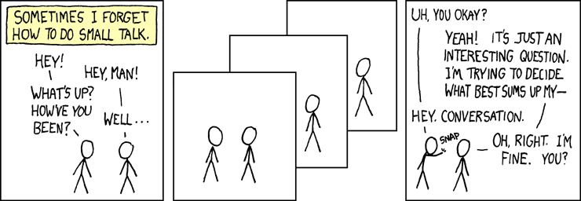

Slide 11
Small Talk: Who, What, Where, When, Why

Slide 12
Small Talk: Who?
Though we often teach children not to talk to strangers, adults are expected to say at least a few words in certain situations.
Strangers who do not know each other at all.
People who are only acquaintances, often called ‘a friend of a friend’.
Office employees who may not be good friends but work in the same department.
Customer service representatives, waitresses, hairdressers and receptionists etc.

Slide 13
Small Talk: What about?
There are certain "safe" topics that people usually make small talk about:
The weather is probably the number one.
Current events (as long as you are not discussing a controversial issue).
Sports news is a very common topic, especially if a local team or player is in a tournament or play-off or doing extremely well or badly.
Entertainment news, such as a celebrity who is in town.

Slide 14
Small Talk: What not about?
There are also some subjects that are NOT considered acceptable when making small talk:
Discussing personal information such as salaries or a recent mishap, is not done between people who do not know each other well.
Compliments on clothing or hair are acceptable; however, you should never say something (good or bad) about a person's physical appearance.
Negative comments about another person not involved in the conversation are also not acceptable.
Also, it is not safe to discuss subjects that the society considers controversial such as religion or politics.

Slide 15
Small Talk: Where?
Most often, small talk occurs in places where people are waiting for something:
In a doctor's or dentist's waiting room, or in queues at the grocery store or a bus stop.
At the office, people make small talk in elevators or lunchrooms and even in restrooms, especially if there is a line-up. ☺
Some social events (such as a party) require small talk among guests who do not know each other very well. It is called "mingling" when people walk around in a social setting and talk to a variety of people.

Slide 16
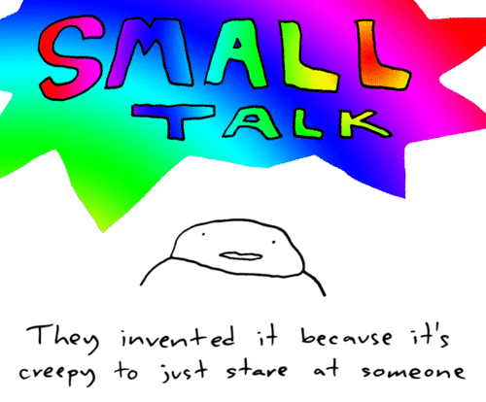
Small Talk: Why?
There are a few different reasons why people use small talk:
The first, and most obvious, is to break an uncomfortable silence.
Another reason, however, is simply to fill time. That is why it is so common to make small talk when you are waiting for something.

Slide 17
Small Talk: Why?
Some people make small talk in order to be polite. You may not feel like chatting with anyone at a party, but it is rude to just sit in a corner by yourself.
After someone introduces you to another person, you do not know anything about them, so in order to show a polite interest in getting to know them better, you have to start with some small talk.
It is called "mingling" when people walk around in a social setting and talk to a variety of people.

Slide 18
Small Talk: Synonyms
chat
a friendly conversation
chatter
continuous fast informal talk, usually about unimportant subjects
small talk
informal conversation about things that are not important
chit-chat
friendly conversation about things that are not very important

Slide 19
Small Talk and Professional Communication
https://www.youtube.com/watch?v=FhVjitk0oOQ

Slide 20
Small Talk and Professional Communication
The ability to make small talk is a vital skill for business people.
In many cultures — for example, China — people put great emphasis on getting to know their business partners, and feeling comfortable with them, before making deals with them.
In English-speaking countries, such as Britain and America, it is also common to “oil the wheels” of business with small talk. Following are some tips on making small talk.

Slide 21
Small Talk and Professional Communication
Be open:
Use open questions starting with “when”, “where”, “how”, “how long” etc. For example: “When did you arrive in Pakistan?” or “What do you think of Hunza so far?”
2. Give feedback, add information:
As the listener in a conversation, you can encourage the speaker by giving verbal and non-verbal feedback and adding extra information to keep the conversation going.
3. Keep small talk small:
Remember that your business partners do not want to hear a detailed report of your medical troubles. Say “I am good/fine, Thank you. How about you”? Or “actually I’m not feeling too good today, but I’ll be fine.”

Slide 22
Small Talk and Professional Communication
4. LIMIT THE WORD “I” TO A MINIMUM:
Tell your story in the short version. Show interest in what he/she is saying. asking questions about the subject.
5. MAKE OTHERS FEEL IMPORTANT BY EYE CONTACT AND FOLLOW-UP QUESTIONS. You can do this by eye contact, and asking follow-up questions. *not looking at a cell phone.
6. AVOID WHISPERING
Whispering is risky because it sends the wrong message. It could be viewed as gossiping or being secretive, and it could negatively affect your image at work.

Slide 23
Small Talk and Professional Communication
7. SPEAK IN A LANGUAGE THAT IS INCLUSIVE:
Use a language understandable to all.
8. TRY TO REMAIN NEUTRAL ON CONTROVERSIAL TOPICS, OR GIVE YOUR VIEW IN A POLITE WAY.
If someone else brings up a controversial topic, or wants your opinion about something, try to be diplomatic in your response (meaning, try to see both sides). OR, if you do give your honest opinions, be polite while doing so, and avoid “proving your point” too much.

Slide 24
Classic small talk topics in business
Health (for example, “How have you been recently?”),
Travel (“How was your flight?”).
Accommodation (“How is your hotel?”).
Family (“How old are your children now?”).
Holidays (“Where did you go on holiday this year?).
Weather (“How’s the weather been here recently?”).

Slide 25
Getting down to business
Watch the video and discuss how to move from small talk to business.
https://www.youtube.com/watch?v=OLXBjnjkot4
To make the transition to business, you can use phrases such as:
Ok, everyone, let’s get down to business.
Ok, everyone. We’ve got a lot on the agenda today, so let’s get started.
Well, everyone’s here now, so let’s start the meeting.
If you’d like to take your seats now, please. It’s time to get down to business.
“Shall we get started”?

Slide 26
And more small talk…
Many business people make the mistake of believing that small talk comes only at the start, before the “real business”. However, although you should not waste time in meetings or negotiations, look out for signals from your business partners that they, too, are ready for a short break from business talk. Often, short interludes of small talk during the business section can help to improve relations and make it easier to reach the deal you want.

Slide 27
Business small talk tip: Things in common
Small talk is about finding a connection with the person you are talking to.
Listen carefully to the information people share with you in a conversation and try to follow with a question to find out more.
As soon as you find a topic on which you both have plenty to say, you’ll be off to a good start. If you can find a topic that you are both interested in, conversation should flow quite easily.

Slide 28
Business small talk tip: Changing the subject
You may want to change the subject because you find the current small talk topic awkward, or because you would like to start talking about business. Using the following English expressions can help make the transition smooth:
Anyway ...
So, tell me …
Oh, by the way…

Slide 29
Ending a conversation
Ending small talk can feel as awkward as starting the conversation.
To end a conversation politely:
Tip 1: Provide a rationale for ending the conversation.
Tip 2: Leverage your immediate surroundings to create the rationale.
Tip 3: Foreshadow the ending.
Oh well, I’d better get back to work.
I’d love to talk for longer, but I need to be in a meeting in 5 minutes.
It’s been great catching up with you. Let me know how the presentation goes, won’t you?
Well, I won’t keep you any longer. I know how busy you are at the moment.
It’s been great hearing about … . See you at next month’s sales meeting.

Slide 30
The Fine Art of Small Talk
• Engage anyone in conversation with poise and confidence
• Revive a dying conversation
• Come across as composed and self-assured when talking to people or entertaining clients at conventions, trade shows, and other work related functions
• Become an "active" listener
• Overcome communication barriers
• Handle awkward situations
• Come up with topics to discuss
• Avoid conversation "killers"
• Develop business friendships
• Prepare for successful conversation
• Remember names and use them properly
• Exit conversations with tact, with grace
• Feel more at ease at parties, banquets, receptions, and networking events

Slide 31
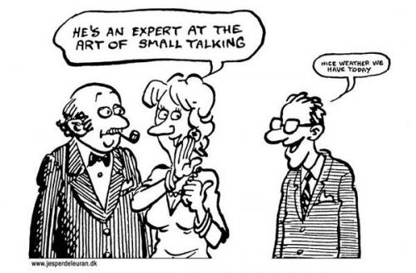

Slide 32
Small Talk: Conversation Starters
Talking about the weather
Beautiful day, isn't it?
Can you believe all of this rain we've been having?
It looks like it's going to snow.
I hear they're calling for thunderstorms all weekend.
We couldn't ask for a nicer day, could we?
How about this weather?
Did you order this sunshine?

Slide 33
Small Talk: Conversation Starters
Talking about current events
Did you catch the news today?
Did you hear about that fire on Fourth St?
What do you think about this transit strike?
I read in the paper today that the Sears Mall is closing.
I heard on the radio today that they are finally going to start building the new bridge.

Slide 34
Small Talk: Conversation Starters
At the office
Looking forward to the weekend?
Have you worked here long?
I can't believe how busy/quiet we are today, can you?
Has it been a long week?
You look like you could use a cup of coffee.
What do you think of the new computers?

Slide 35
Small Talk: Conversation Starters
At a social event
So, how do you know Justin?
Have you tried the cabbage rolls that Sandy made?
Are you enjoying yourself?
Pretty nice place, huh?
I love your dress. Can I ask where you got it?

Slide 36
Small Talk: Conversation Starters
Out for a walk
How old's your baby?
What's your puppy's name?
The tulips are sure beautiful at this time of year, aren't they.
How do you like the new park?
Nice day to be outside, isn't it?
Waiting somewhere
I didn't think it would be so busy today.
The bus must be running late today.
It looks like we are going to be here a while, huh?
I'll have to remember not to come here on Mondays.
How long have you been waiting?

Slide 37
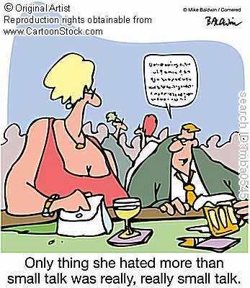
Small Talk Quiz

Slide 38
Put the conversation in order
A: Hello again, Barbara. How are you? It’s Alicia. We met in Paris last year.
B: Oh yes. I didn’t recognise you. Your hair’s different. I’m fine. What about you?
A: I’m vey well thanks.
B: And how’s business, Alicia?
A: It’s going well, especially in Spain.
B: Great.
A: Barbara, I’d like you to meet one of our best customers from there, Carlos Gonzalez from Madrid.
B: Hello, Carlos. Nice to meet you. I’ve heard a lot about you.
C: Not all bad I hope!
B: Not at all. It’s good to be able to put a face to a name.
C: Absolutely!

Slide 39
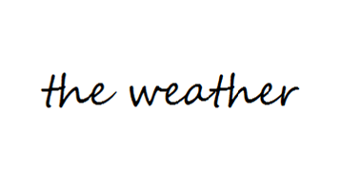
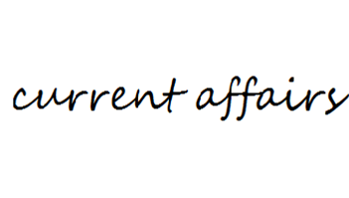
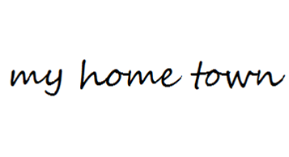

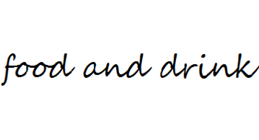
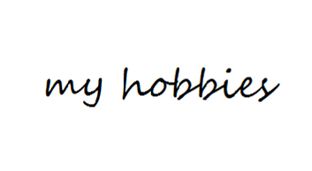

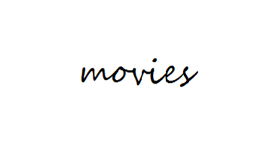


Task: Work in groups of 3-4 members to Make Small Talk any topic you like.

Slide 40
Work in pairs and write short dialogues for the given situations
Starting a conversation: introducing yourself
Introducing someone else in English
Reconnecting with someone (Oh, hi, Susan! I thought I recognized you. How are you?)
Starting a conversation: Meeting in person
You don’t remember me? (I’m sorry. Can you jog my memory?)
Travel small talk
Small talk about your background
Asking someone where they come from
Small talk about your accommodation
Small talk about the weather
Small talk about your family
Telling a story
Small talk about work
Saying Goodbye

Slide 41
Activities from the handout.

